Slide 1
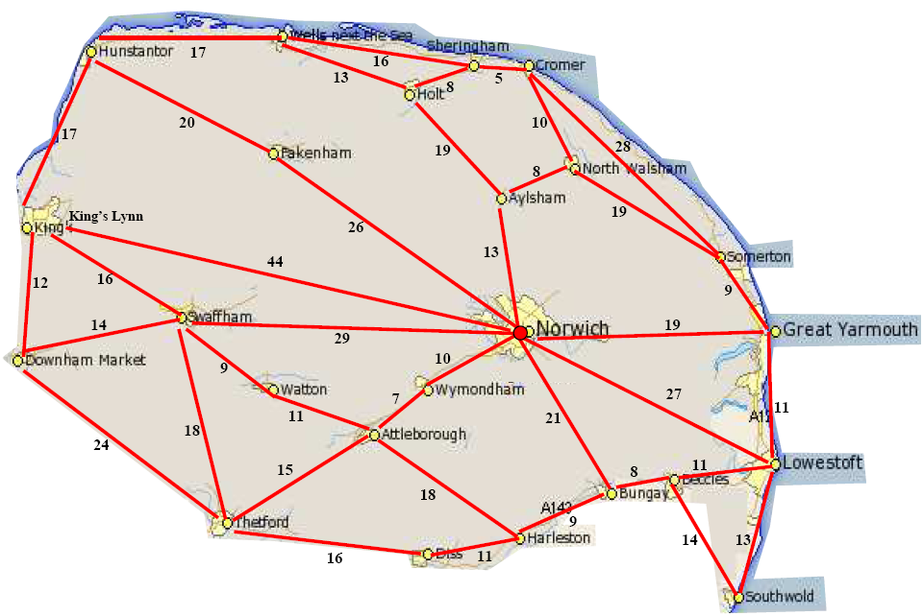
Gotta catch ‘em all
Pokemon in each place
Attleborough 3
Aylsham 2
Beccles 4
Bungay 3
Cromer 5
Diss 4
Downham Market 3
Fakenham 6
Great Yarmouth 7
Harleston 2
Holt 3
Hunstanton 4
Kings Lynn 6
Lowestoft 6
North Walsham 4
Norwich 10
Sherringham 5
Somerton 1
Southwold 3
Swaffham 5
Thetford 5
Watton 2
Wells 2
Wymondham 5
Start and end in Norwich

