Slide 1
NOA Bridging Project Maths
This work is going to your next school.
Notes:
The livery for the powerpoint is deliberately blank. This has been provided so that individual staff or primary schools may simply add their own logos etc.

Slide 2
You have to travel around Norfolk and North Suffolk.
You have to visit every town.
Your challenge is going to every town with minimum number of miles.
You can visit each town as often as you need to.

Slide 3
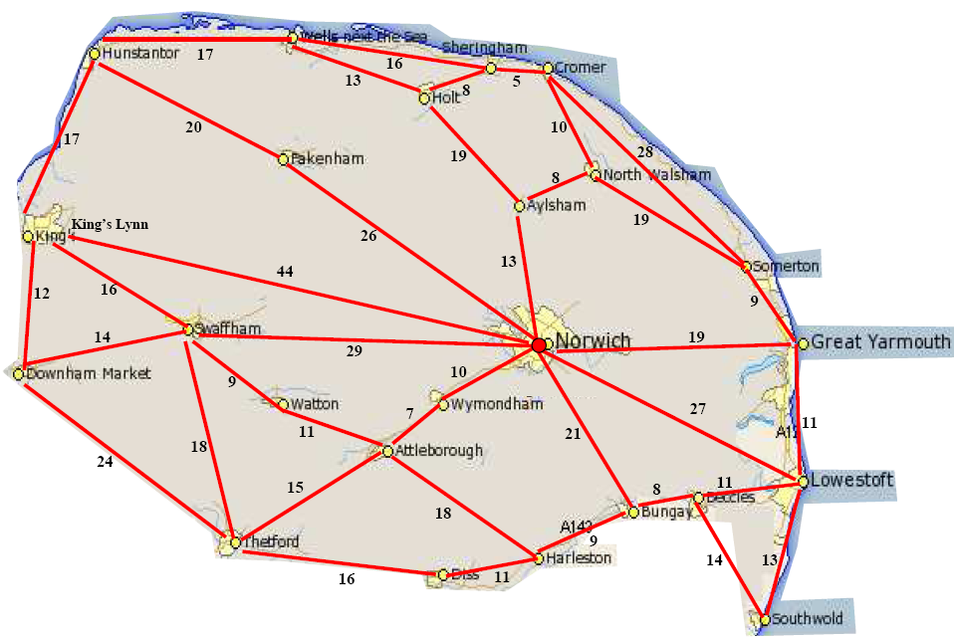
Start and End here

Slide 4
Town | Cumulative Mileage
Norwich | 0
Great Yarmouth | 19
Lowestoft | 19+11 = 30
Beccles | 30 + 11 = 41
In your book:
Draw the table.
Write down how you decided upon your route.
Extension: Does it make a difference if you start somewhere else? Try starting at a beach resort.
Notes:
It works best if the pupils have a large A3 map with counters on it. The least able can work with TAs to help them keep on track.

