Slide 1
5
28
These words are homophones or near homophones. They have the same pronunciation but different spellings and/or meanings.

Slide 2
5
These words are homophones or near homophones. They have the same pronunciation but different spellings and/or meanings.
28
Introduction | Ask the children what the word homophone means. Can they think of any examples? Define them as words which have the same pronunciation but different meanings and/or spellings. Discuss near homophones have slightly different pronunciations.
Main Teaching Activity | Get the children to look at the five pictures and decide which of the spelling words match each one. Discuss the spellings and any misconceptions.
Independent Activity | Ask the children to write a sentence for the remaining 5 words, work in pairs to check spellings, understanding of words and to improve the sentences. Write the final sentences up in neat handwriting. Share with the class.
Spellings
cereal
serial
complement
compliment
principal
principle
stationary
stationery
wary
weary

Slide 3
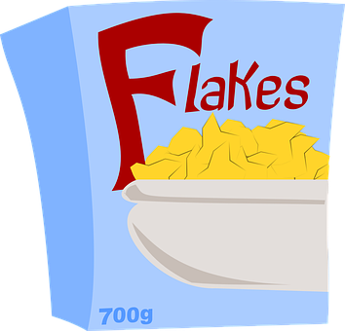
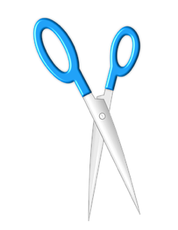
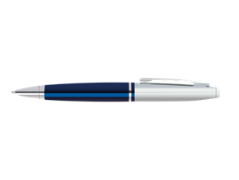
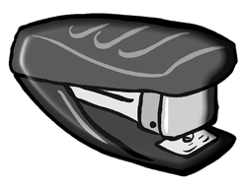
principal
cereal
stationary
compliment
weary

Slide 4
Stage: 5 | These words are homophones or near homophones. They have the same pronunciation but different spellings and/or meanings. Name:
List: 28
Spellings | 1st Attempt | 2nd Attempt | 3rd Attempt | 4th Attempt | 5th Attempt
cereal
serial
complement
compliment
principal
principle
stationary
stationery
wary
weary

Slide 5
Stage: 5 | These words are homophones or near homophones. They have the same pronunciation but different spellings and/or meanings. Name:
List: 28
Spellings
cereal
serial
complement
compliment
principal
principle
stationary
stationery
wary
weary
Marvin has completed his homophone homework below.
Can you mark it? Correct any spelling errors for him.
Dear Diary,
After eating my serial, I set off for school in the rain. I arrived late looking somewhat dishevelled which earned me a telling off from the principle. I tried to complement him on his new suit but this just got me another reprimand. I entered my classroom ready to start my work feeling tired and wary. I emptied my bag and realised I had forgotten my books and all of my stationary. After that the day just got worse.

Slide 6
Stage: 5 | These words are homophones or near homophones. They have the same pronunciation but different spellings and/or meanings. Answers:
List: 28
Spellings
cereal
serial
complement
compliment
principal
principle
stationary
stationery
wary
weary
Marvin has completed his homophone homework below.
Can you mark it? Correct any spelling errors for him.
Dear Diary,
After eating my cereal, I set off for school in the rain. I arrived late looking somewhat dishevelled which earned me a telling off from the principal. I tried to compliment him on his new suit but this just got me another reprimand. I entered my classroom ready to start my work feeling tired and weary. I emptied my bag and realised I had forgotten my books and all of my stationery. After that the day just got worse.

